Slide 1

Customer_Retention case study
Prepared By:
SNEHA SANTRA

Slide 2
Potential
Benefits
Solution Process
Key Findings
Recommendation
Problem Overview
AGENDA

Slide 3
Problem Overview
What is the problem?
Customer satisfaction has emerged as one of the most important factors that guarantee the success of online store; it has been posited as a key stimulant of purchase, repurchase intentions and customer loyalty.
Main problem is to find the key for customer satisfaction.
how we can decrease the chances of getting thproblem by some preventive measures?
Five major factors that contributed to the success of an e- commerce store have been identified as: service quality, system quality, information quality, trust and net benefit.
In the next steps we will see how we can use our insights in the business domain.

Slide 4



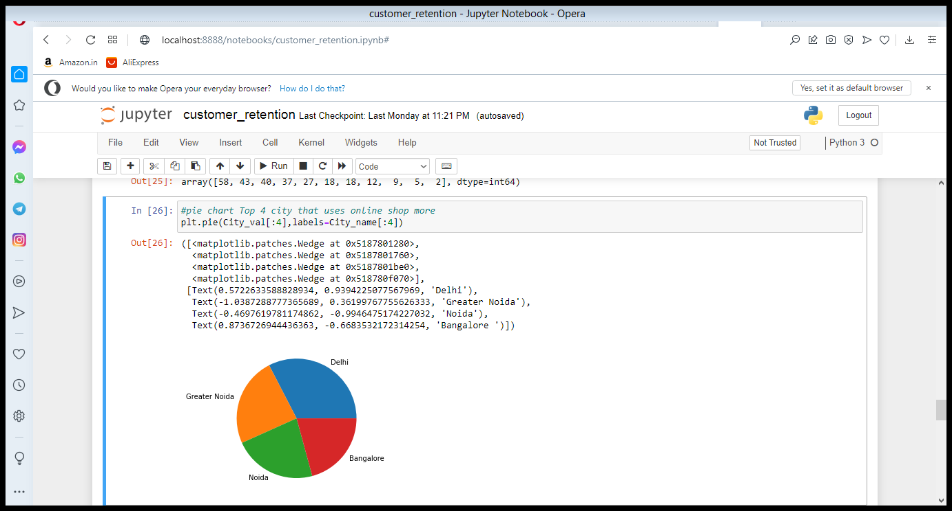

Visualisation
Model Validation
MDe measure on
testing data
Dataset is provided by flioprobo technology
Dataset is-customer_restection_dataset
There are 71 columns and 269 rows.and we are observed which city is more often for online shoppig and which online site is used more
STEP
04
Model Preparation
We teach the model
on Training dataset,
STEP
03
Analytical approach
Supervised Machine Learning problem,
Two class Classification,
STEP
02
Analyse Data
Heterogeneous population, Anomaly Treatment, Missing Values Treatment, creating new variable
STEP
01

Slide 5








Key Insights
The most important factors that influence the problem
Gender
Trust
City
Net benefit
Service quality
System quality
How often online shopping done
Favourite online site

Slide 6
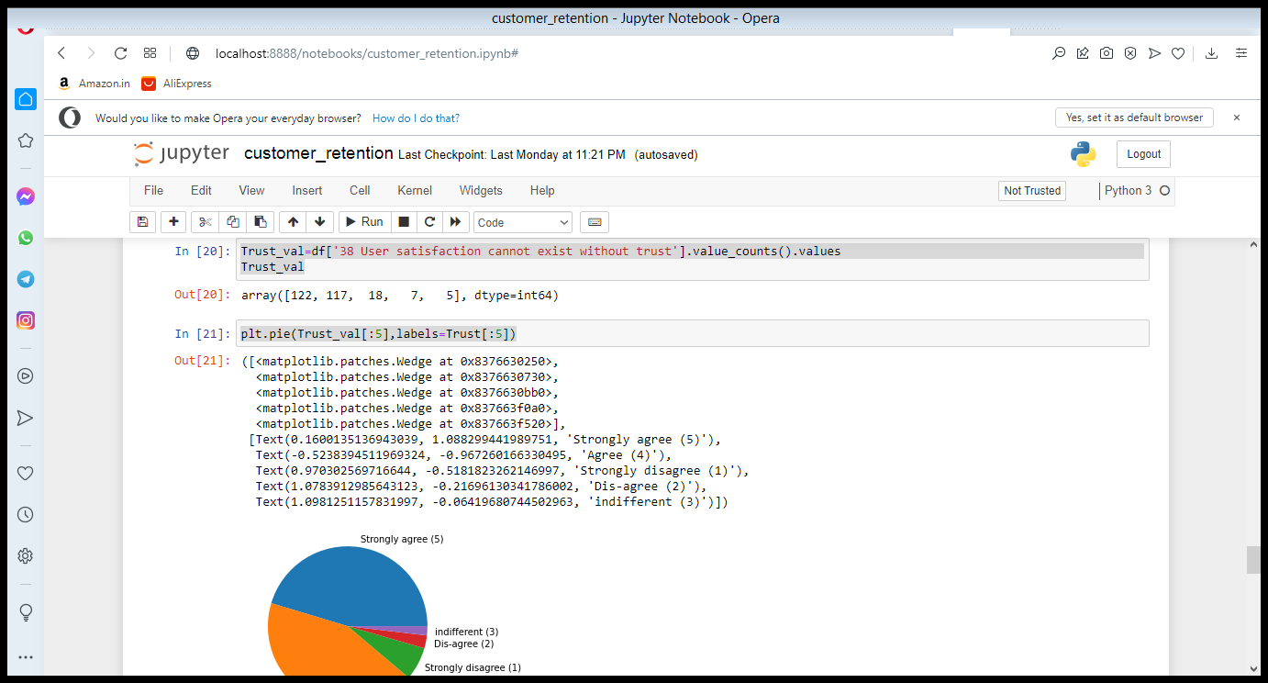
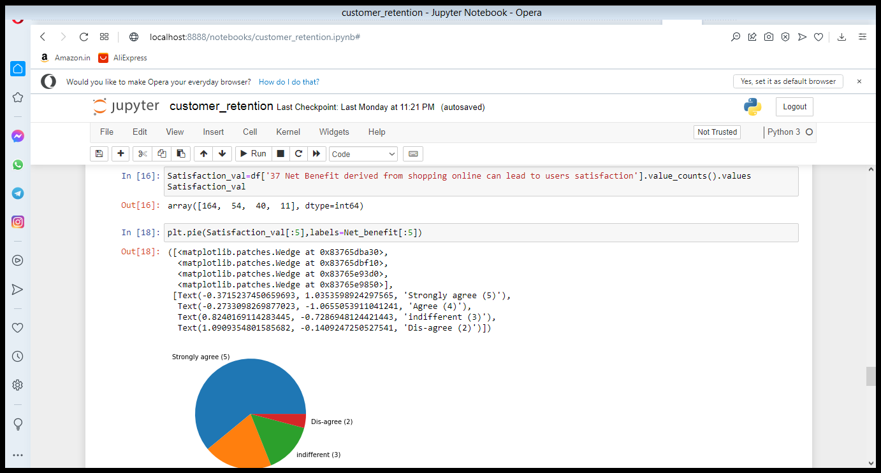
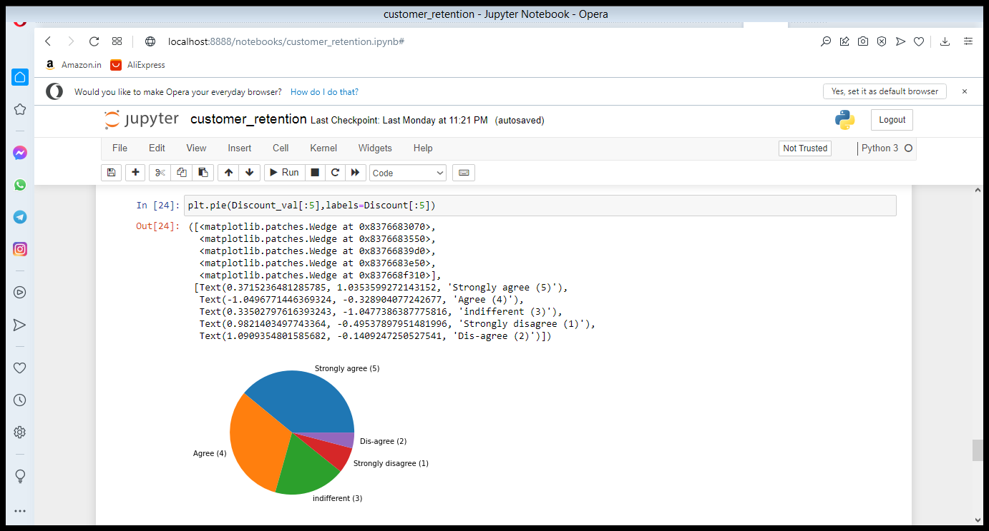
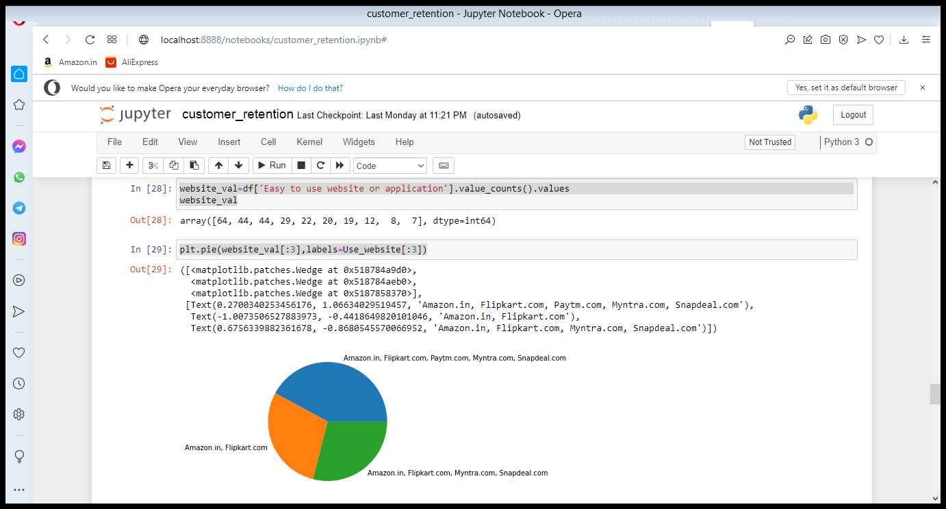
Discount given
Most used onine site
Net benefit
Customer Trust
City
Preventing Measures

Slide 7
Conclusion
The main subject is to satisfaction of the customer and we clearly see it people are strongly agree that online shopping is giving more discount and and it is most trustworthy and the net benefit derived from online shopping is more user satisfaction we clearly say it most of the people is used online shopping and sale is going to increase

Slide 8

ThankYou

